Slide 1

Innovation in CATV powering design
In the early stages of the CATV industry trunk & drop coaxial cables & power amplifiers were used to reach the end user.
Due to a high demand on network usage the fiber optic applications are extended closest to the customers’ premises leaving most of the existing coaxial cables unused.
Safecom is now offering advance technology to reuse those existing coaxial cables as a power & two way backup platform to all optical nodes at FTTN, FTTC , FTTB & FFTH networks.
This new system offers the most reliable powering solution while saving enormous Capital & Operational costs for individual powering feeds & maintenance costs for batteries .

Slide 2
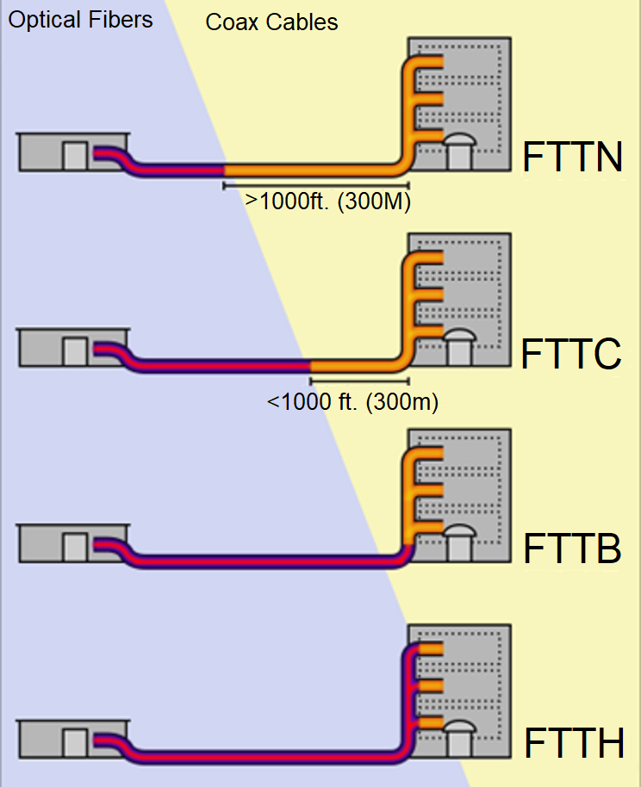
Typical Optical & HFC networks
Fiber to the node
Fiber to the curb
Fiber to the building
Fiber to the home

Slide 3
Central Powering for FTTH networks via existing Coaxial Cables
Existing trunk Coaxial cable or power cable
24 Vac Tap
Tap-AC–AC Down Converter
+Power through
1
Existing CATV P.S
3
4
63Vac (EU)
87Vac (US)
63Vac (EU)
87Vac (US)
63Vac (EU)
87Vac (US)
63Vac (EU)
87Vac (US)
63Vac (EU)
87Vac (US)
24Vac
24Vac
24Vac
Existing Drop Coaxial cables (RG 11, RG 6) or power cable
24Vac
5
12Vdc
12Vdc
12Vdc
12Vdc
12Vdc
12Vdc
12Vdc
12Vdc
24Vac-12VDC
Down converter & regulator
7
FTTH – Optical Node
6

Slide 4
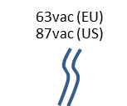
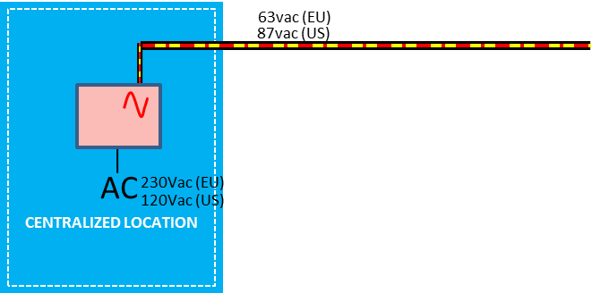
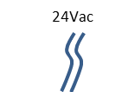
Central Powering for FTTH networks via existing Coaxial Cables
Existing trunk Coaxial cable or power cable
24 Vac Tap
Tap-AC–AC Down Converter
+Power through
3
4
5
24VAC
Existing Drop Coaxial cables (RG 11, RG 6) or power cable
12Vdc
12Vdc
1
Existing CATV P.S
6
7
24Vac-12VDC
Down converter & regulator
FTTH – Optical Node
8
Optical fiber

Slide 5
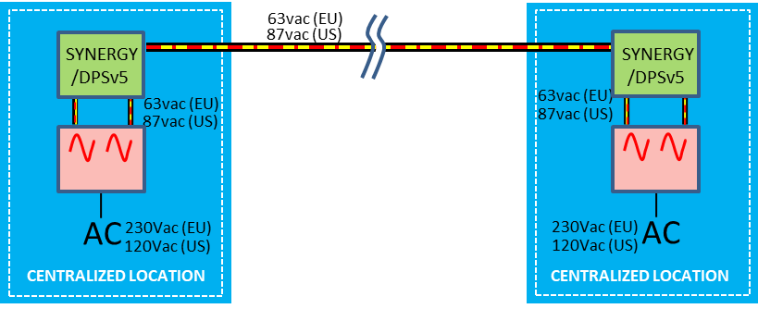

Remote Power redundancy system for FTTH networks via existing Coaxial Cables & on-line AC phase controller
Area A
Area B
AC Phase controller
SYNERGY or DPSv5
24 Vac Tap
Tap-AC–AC Down Converter
+Power through
4
2
24VAC
5
Existing Drop Coaxial cables (RG 11, RG 6) or power cable
24VAC
12Vdc
12Vdc
3
Existing trunk Coaxial cable or power cable
6
7
1
24Vac-12VDC
Down converter & regulator
FTTH – Optical Node
Existing CATV P.S or Dual port P.S
8
Optical fiber

Slide 6
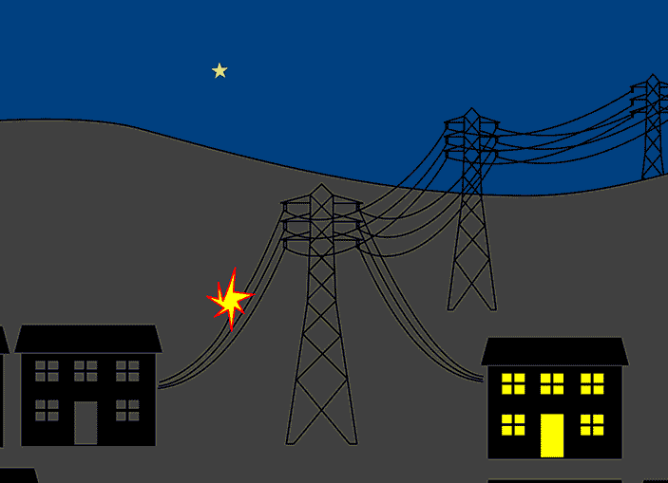



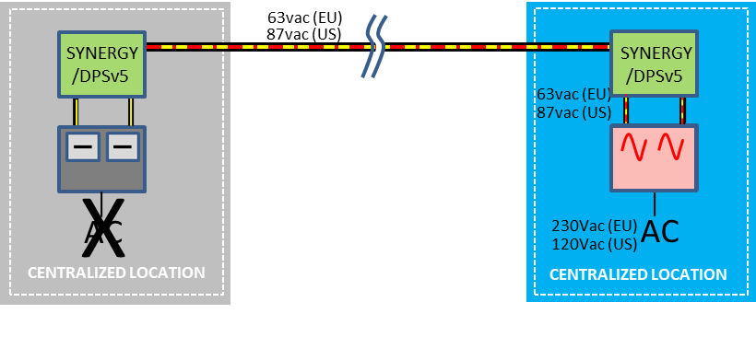


FTTH operates using remote redundant AC power
Backup simulation
Area A- Power outage
Area B
Backup from Area B
AC Phase controller
SYNERGY or DPSv5
Voltage stabilizing
Voltage drop
24 Vac Tap
Tap-AC–AC Down Converter
+Power through
4
2
63Vac (EU)
87Vac (US)
24Vac
5
Existing Drop Coaxial cables (RG 11, RG 6) or power cable
24VAC
24Vac
12Vdc
12Vdc
3
Existing trunk Coaxial cable or power cable
6
7
1
24Vac-12VDC
Down converter & regulator
FTTH – Optical Node
Existing CATV P.S or Dual port P.S
8
Optical fiber

Slide 7

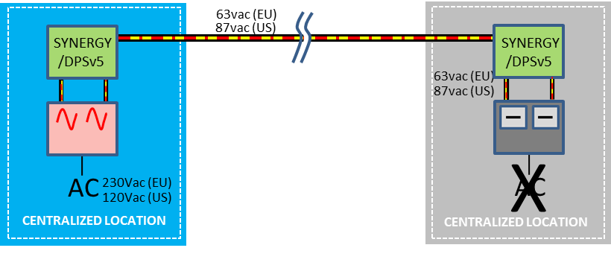
FTTH operates using remote redundant AC power
Backup simulation
Area A
Area B- Power outage
Backup from Area A
AC Phase controller
SYNERGY or DPSv5
Voltage drop
Voltage stabilizing
24 Vac Tap
Tap-AC–AC Down Converter
+Power through
4
2
24VAC
5
Existing Drop Coaxial cables (RG 11, RG 6) or power cable
24VAC
24Vac
12Vdc
12Vdc
Existing trunk Coaxial cable or power cable
3
6
7
1
24Vac-12VDC
Down converter & regulator
FTTH – Optical Node
Existing CATV P.S or Dual port P.S
8
Optical fiber

Slide 8
Max distances range between central powering locations (area A to B) 87V
10A Local Load (Remote 13.9A) 87V |  | 7A Local Load (Remote 10.9A) 87V
Power Booster Gain 1.38 |  | Power Booster Gain 1.52
Max Distance-(Meter) | Max Distance (ft.) | Max Distance-(Meter) | Max Distance (ft.) | Cable
320 | 1,051 | 545 | 1,787 | QR-540
517 | 1,697 | 880 | 2,886 | QR-715
714 | 2,342 | 1,214 | 3,982 | QR-860
300 | 984 | 510 | 1,673 | P3-500
397 | 1,303 | 675 | 2,215 | P3-565
469 | 1,537 | 797 | 2,614 | P3-625
615 | 2,018 | 1,046 | 3,432 | P3-700
680 | 2,229 | 1,155 | 3,790 | P3-750
859 | 2,817 | 1,460 | 4,790 | P3-860
940 | 3,083 | 1,598 | 5,243 | P3-875
1,781 | 5,842 | 3,028 | 9,934 | PF-625

Slide 9
Max distances range between central powering locations (area A to B) 63V
10A Local Load (Remote 13.9A) 63V |  | 7A Local Load (Remote 10.9A) 63V
Power Booster Gain 1.38 |  | Power Booster Gain 1.52
Max Distance-(Meter) | Max Distance (ft.) | Max Distance-(Meter) | Max Distance (ft.) | Cable
211 | 692 | 359 | 1,178 | QR-540
341 | 1119 | 580 | 1,903 | QR-715
471 | 1545 | 801 | 2,628 | QR-860
198 | 650 | 337 | 1,106 | P3-500
262 | 860 | 445 | 1,460 | P3-565
309 | 1,014 | 526 | 1,726 | P3-625
405 | 1,329 | 690 | 2,264 | P3-700
448 | 1,470 | 762 | 2,500 | P3-750
567 | 1,860 | 963 | 3,159 | P3-860
620 | 2,034 | 1,054 | 3,458 | P3-875
1,175 | 3,855 | 1,998 | 6,555 | PF-625

Slide 10
Innovation in CATV powering design
SAFECOM offers CATV operators a simple to way install the most reliable powering platforms for optical nodes while saving both Capital & Operating expenses.
Advantages
Saving the needs for individual powering & backup to each optical nodes using remote powering Without batteries | Saving Capital expenses
No maintenance Unlimited lifetime Without Batteries | Saving operational expenses
Unlimited backup time Online RF transmission during operation. (INTERNET, VOD, VOIP) | Service & reliability
Water-proof Enclosure (IPX8) | Weather protected
Electronic fuses Overload protection Surge protected 100KA & 140KA Opposite connection protected | Safety
Zero crossing technology Two way powering on a single cable Voltage stabilizing | Advanced patented technologies
Full DOCSIS® & EuroDOCSIS HMS integrated Status Monitoring | Monitoring

