Slide 1
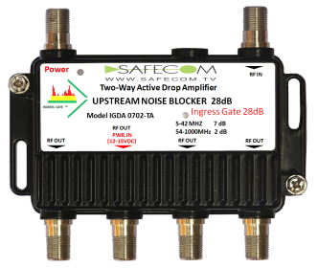
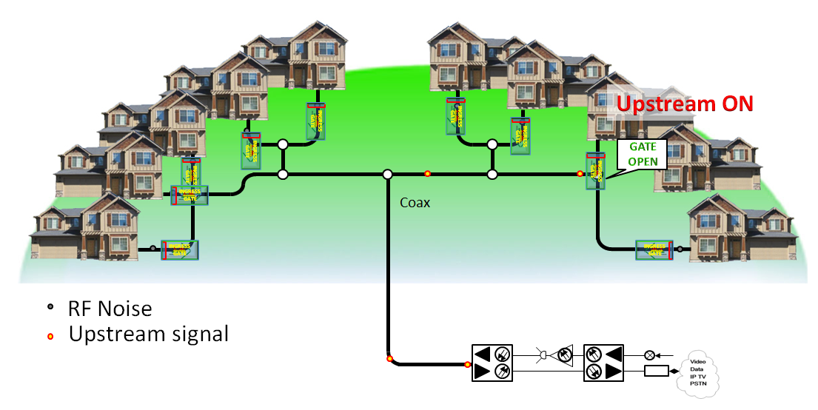
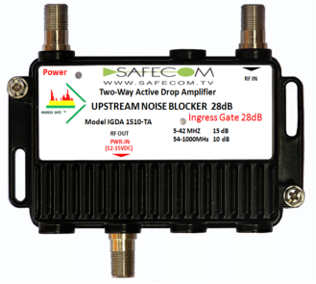
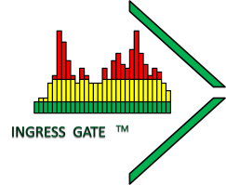
Safecom INGRESS GATE technology (US,EP Patent)
28dB UPSTREAM RF & INGRESS NOISE BLOCKER
Solving the “Funneling Effect” at HFC & RFoG networks
Allows carrier signals from customer premises into the network only when the home devices are actively transmitting
Tel +972-544311933 / Fax +972-9-7968033 /
Habustan st (PO 132) / Israel 40691/ E-mail david@safecom.tv

Slide 2
The Concept & Benefit:
Upstream gateway that fully synchronizes with the Cable modem, EMTA, Setup box (patent p).
Enables upstream signal only when modem is active.
Blocks upstream & ingress noise by > 28dB.
Optimizes CMTS-CABLE Modem communication.
Solves the “Funneling Effect” at HFC & RFoG networks.
Tel +972-544311933 / Fax +972-9-7968033 /
Habustan st (PO 132) / Israel 40691/ E-mail david@safecom.tv

Slide 3


Fast & Simple
Standalone home upstream noise blocker or Ingress Gate embedded inside Home amplifier (Active , Passive return).
4 output
-7,0,7 dB downstream gain available.
0 ,5,10 dB upstream gain available.
1 output
0,10,15 dB gain available downstream.
0 ,5,10 dB gain available upstream
Self-controlled without the need for expensive extra monitoring or complicated remote operation.
Simple integration outdoor or indoor.
Plug and play device.
Best performance in the market.
Low Cost.
Tel +972-544311933 / Fax +972-9-7968033 /
Habustan st (PO 132) / Israel 40691/ E-mail david@safecom.tv

Slide 4
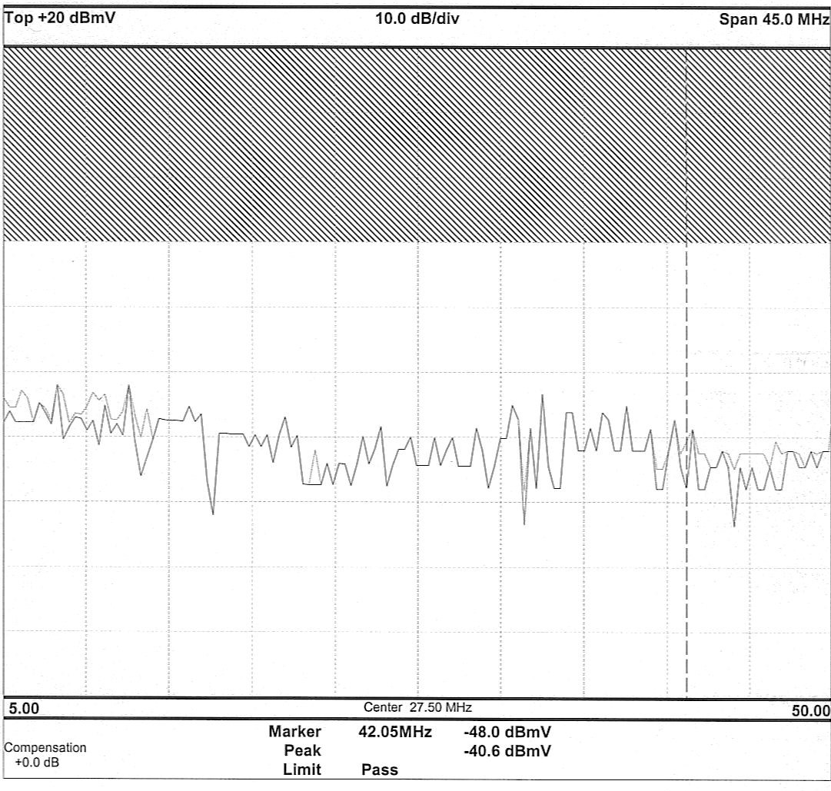
“Passing” Upstream
Tel +972-544311933 / Fax +972-9-7968033 /
Habustan st (PO 132) / Israel 40691/ E-mail david@safecom.tv

Slide 5
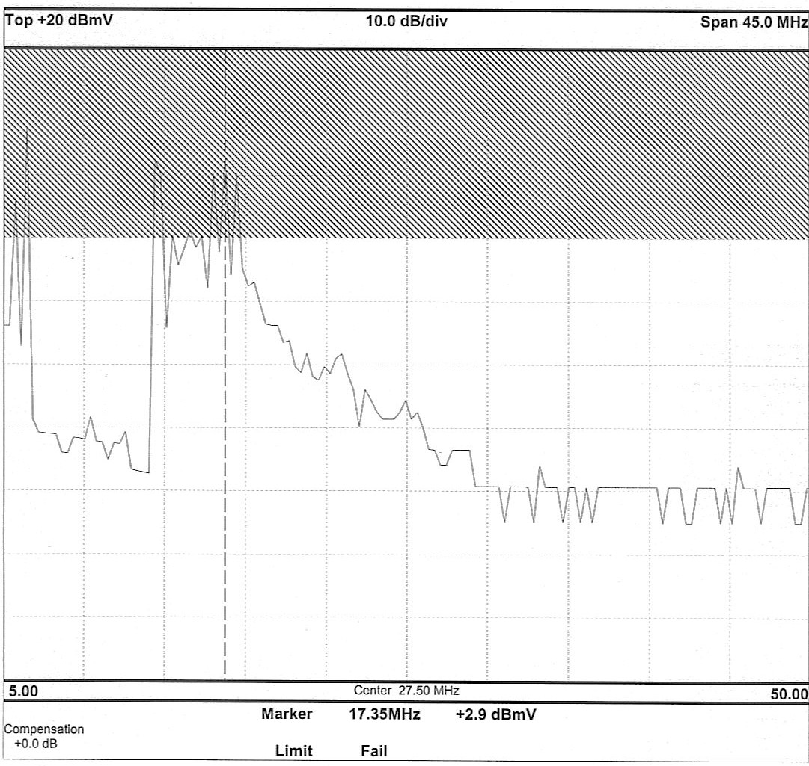
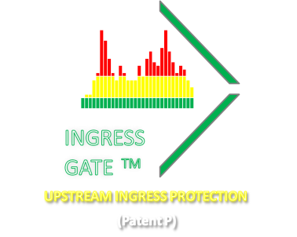
“Falling” Upstream
Tel +972-544311933 / Fax +972-9-7968033 /
Habustan st (PO 132) / Israel 40691/ E-mail david@safecom.tv

Slide 6
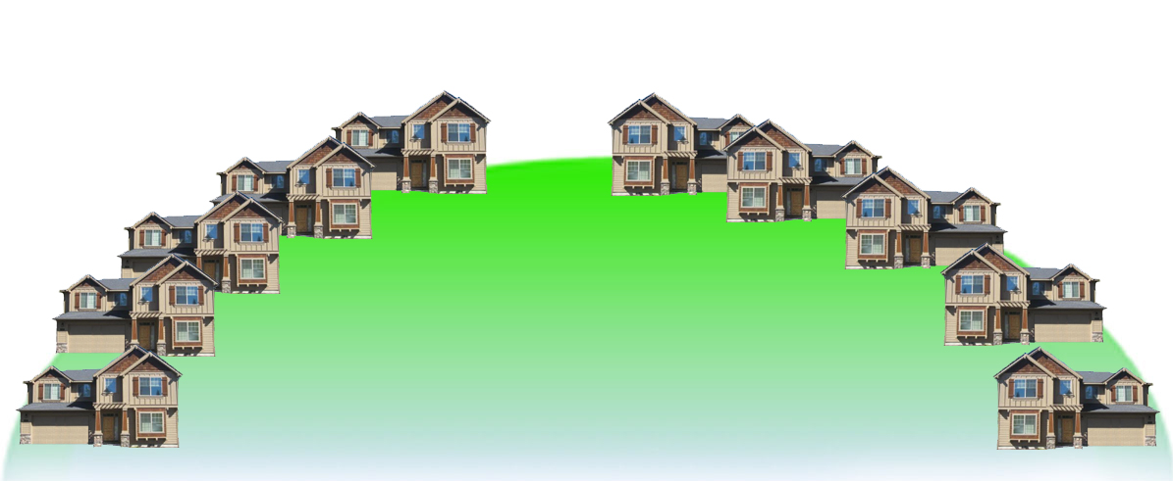

1
About “Funneling Effect”
Coax
RF Noise
RF Noise from CATV subscriber homes flows into the network and blocks the upstream path.
“Funneling Effect” shows the structural failing of “the last two-way signal over coax part”.
Tel +972-544311933 / Fax +972-9-7968033 /
Habustan st (PO 132) / Israel 40691/ E-mail david@safecom.tv

Slide 7
“Funneling Effect” slow down & interrupt upstream transmission of the internet.
Upstream ON
Coax
RF Noise
Upstream signal
“Funneling Effect” limits performance of the network, slowing and interrupting the Internet connection while concealing the superiority of the CMTS-CM Model.
Tel +972-544311933 / Fax +972-9-7968033 /
Habustan st (PO 132) / Israel 40691/ E-mail david@safecom.tv

Slide 8
INGRESS GATE Eliminates “Funneling Effect”
ULTRA –HIGH SPEED BROADBAND NETWORKS
Upstream ON
INGRESS GATE
INGRESS GATE
INGRESS GATE
GATE
OPEN
INGRESS GATE
INGRESS GATE
INGRESS GATE
Coax
INGRESS GATE
INGRESS GATE
RF Noise .
Cable modem -Upstream signal .
Principle of solving “Funneling Effect” by safecom’s ingress Gate technology:
Ingress Gate opens the upstream channel only when home devices are actively transmitting.
Ingress Gate keeps all other upstream paths closed, therefore other upstream RF noise blocked when each path at a time transmit a signal to CMTS.
Tel +972-544311933 / Fax +972-9-7968033 /
Habustan st (PO 132) / Israel 40691/ E-mail david@safecom.tv

Slide 9
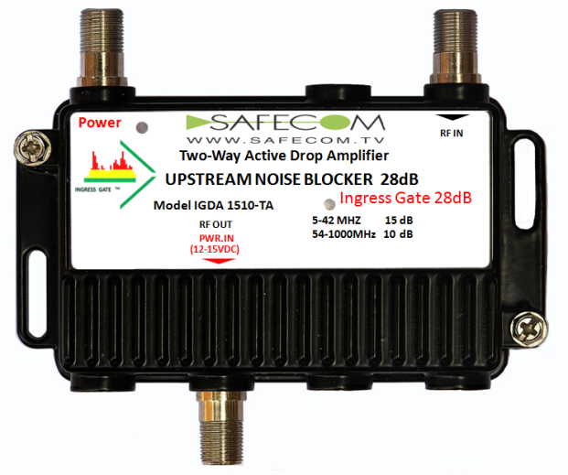
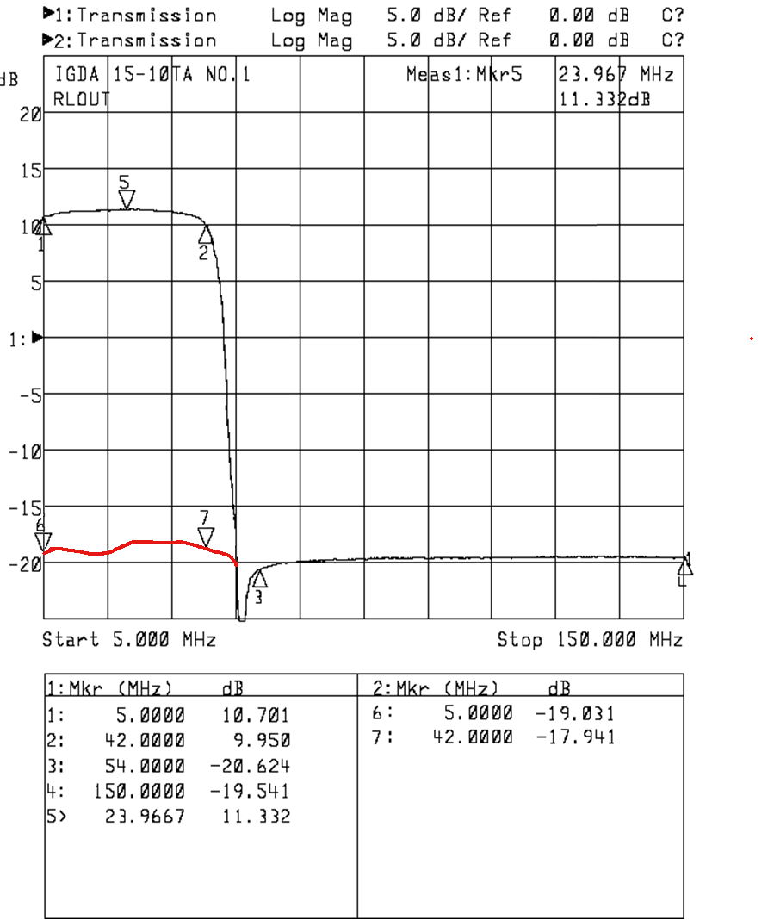
UPSTREAM ON
Upstream RF-Pass
UPSTREAM OFF/ Upstream RF Noise Blocked
Ingress Gate technology blocks upstream noise by > 28 dB and eliminates the “Funneling Effect”. Enables a clean and free upstream path for maximizing Internet performance.
Tel +972-544311933 / Fax +972-9-7968033 /
Habustan st (PO 132) / Israel 40691/ E-mail david@safecom.tv

Slide 10
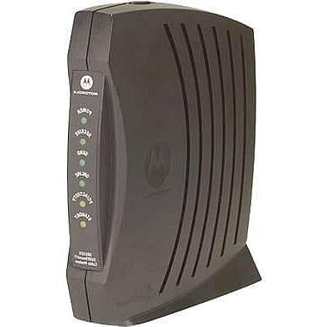
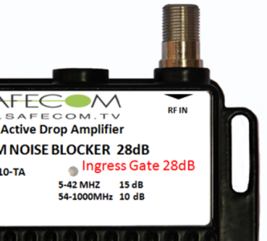
Principle operation of Ingress gate solution
Upstream RF Noise Blocked
55-1000
MHZ
15dB
55-1000
MHZ
5-42
MHZ
Upstream OFF
OFF
5-42
MHZ
5-42
MHZ
55-1000
MHZ
DC Power
OFF
Ingress Gate control
Upstream AMP OFF = RF & Ingress Noise Blocked !!!
Ingress Gate control
Ingress gate control turns upstream amplifier ON & OFF by controlling DC power without any switching.
When modem is not active upstream amplifier is OFF.
Result : Upstream RF noise blocked.
Tel +972-544311933 / Fax +972-9-7968033 /
Habustan st (PO 132) / Israel 40691/ E-mail david@safecom.tv

Slide 11
Principle operation of Ingress gate solution
55-1000
MHZ
15dB
55-1000
MHZ
5-42
MHZ
Upstream ON
10dB
5-42
MHZ
5-42
MHZ
55-1000
MHZ
DC Power
ON
Ingress Gate control
Ingress Gate control
“Ingress gate control” turns upstream amplifier ON & OFF by controlling power of upstream amplifier.
Ingress gate operation controlled and synchronized by cable modem, EMTA, SETUP boxes.
When home devices are actively transmitting Ingress gate Pass the upstream RF.
Tel +972-544311933 / Fax +972-9-7968033 /
Habustan st (PO 132) / Israel 40691/ E-mail david@safecom.tv

Slide 12
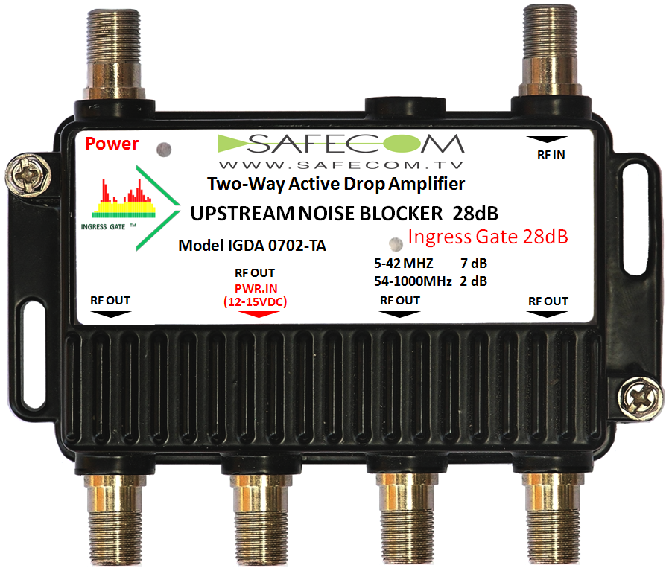
Ingress gate operation controlled and synchronized by CATV home devices that actively transmitting.
Upstream path open only when the home devices are actively transmitting.
Gate open
Gate Closed
Tel +972-544311933 / Fax +972-9-7968033 /
Habustan st (PO 132) / Israel 40691/ E-mail david@safecom.tv

Slide 13
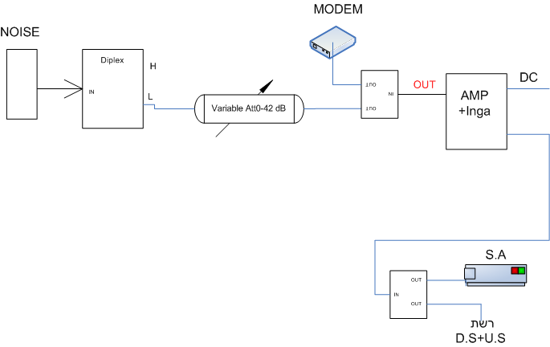
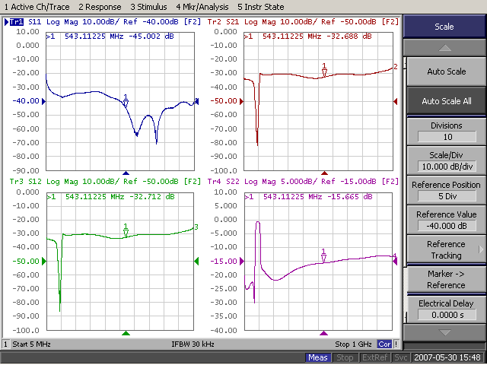

Testing INGRESS GATE Home Amplifier Procedure :
Combine two frequencies and measure noise level by Spectrum Analyzer.
IGDA
AMP
Network
Tel +972-544311933 / Fax +972-9-7968033 /
Habustan st (PO 132) / Israel 40691/ E-mail david@safecom.tv

Slide 14
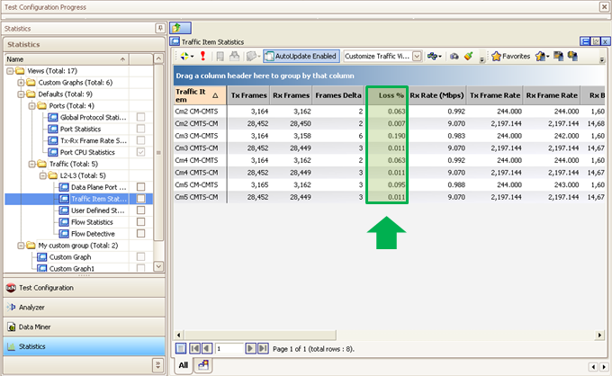
TEST - LOSS % -RX & TX RATE (with very high noise 65dBµV)
Modem transmission using Ingress gate.
Results: No Loss or delay during Ingress gate operation.
Tel +972-544311933 / Fax +972-9-7968033 /
Habustan st (PO 132) / Israel 40691/ E-mail david@safecom.tv

Slide 15
Competitive analysis
Safecom | Company 3 | Company 2 | Company 1
Usage-based upstream Gate Technology : Open only when Modem transmitting | Ingress detection and 6dB attenuation | Frequency Division | turn the upstream path to ON, OFF, or 6 dB attenuation | Technology
Very Low | Med | High | Med | Cost
No | Yes | Yes | Yes | Needs ingress detection system
Home (by customer or technician ) | Network | Network | Network | Installation
No RF disconnections during installation | Disconnect RF signal to large area during installation | Disconnect RF signal to large area during installation | Disconnect RF signal to large area during installation | Broadcast continues during installation
Tel +972-544311933 / Fax +972-9-7968033 /
Habustan st (PO 132) / Israel 40691/ E-mail david@safecom.tv

Slide 16
Safecom’s IngressGate™ (US,EP Patent .) vs. Opposite Phase
IngressGate™ Solution Patented. | Opposite Phase concept.
Operates as upstream gate that opens only when the modem transmits. | Opposite phase merging. | Technology
Full >28 dB ingress isolation. | Partial 0- 6 dB only ingress reduction. | Effectiveness
Full Synchronization with Cable modem | Assumes ingress noises are at the same phase or from the same source. | Operating principle
Solves and blocks all ingress noise from customer premises. | Cannot solve ingress problems from customer premises. | Solution
Tel +972-544311933 / Fax +972-9-7968033 /
Habustan st (PO 132) / Israel 40691/ E-mail david@safecom.tv

Slide 17
Thank You
Safecom INGRESS GATE technology
(US,EP Patent)
Best Solution & performance for blocking upstream & Ingress noise.
Enables optimized upstream path of HFC, RFoG.
Saves the need for network upgrades.
Ensures top-reliability of Internet , VoIP, & VOD.
Lowest cost.
Tel +972-544311933 / Fax +972-9-7968033 /
Habustan st (PO 132) / Israel 40691/ E-mail david@safecom.tv

